Slide 1
Pose Estimation
Group 4
Devesh Datwani
Thabsheer Machingal
Nitant Vyas

Slide 2
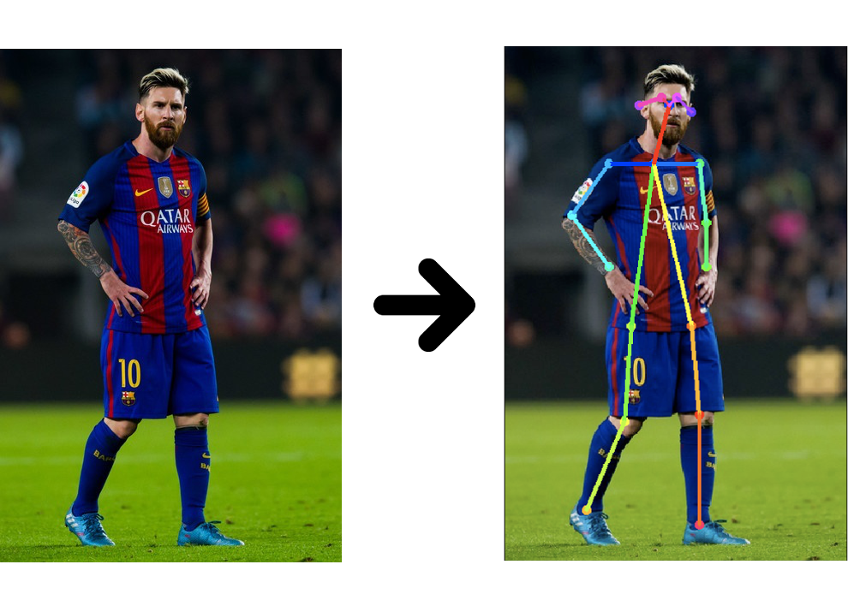
Objective
INPUT
OUTPUT

Slide 3
Desired Outcomes
Learn more about Convolutional Neural Networks
Learn how to implement a paper on CNN
Learn Pose Estimation

Slide 4
Why Pose Estimation?
Track athlete performance / postures
Agent intention prediction for autonomous vehicles
Human health evaluation
AR video games

Slide 5
Methodology
Paper => DeepPose by Alexander Toshev, Christian Szegedy
Machine Learning Technique => Convolution Neural Network (with a regressor)
Neural Network Libraries => Tensorflow, Keras
Dataset => FLIC Pose Dataset
Dataset Size ~ 5003 images
Training Tool = Google Colab notebook that runs a virtual Nvidia K80 / T4 GPU

Slide 6
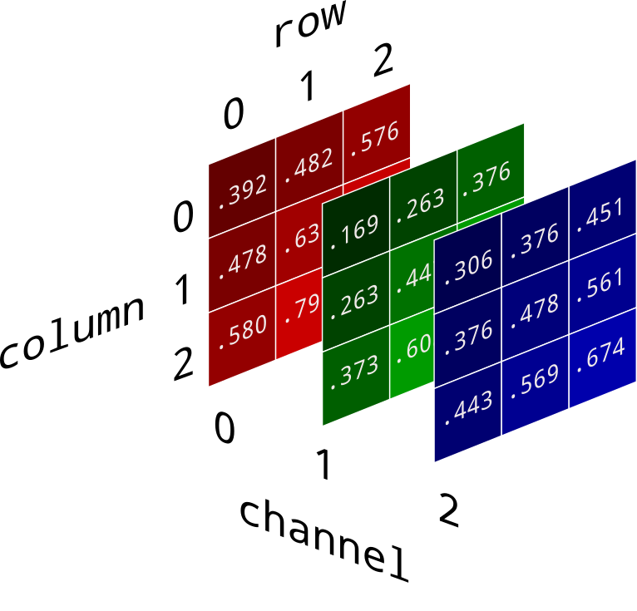
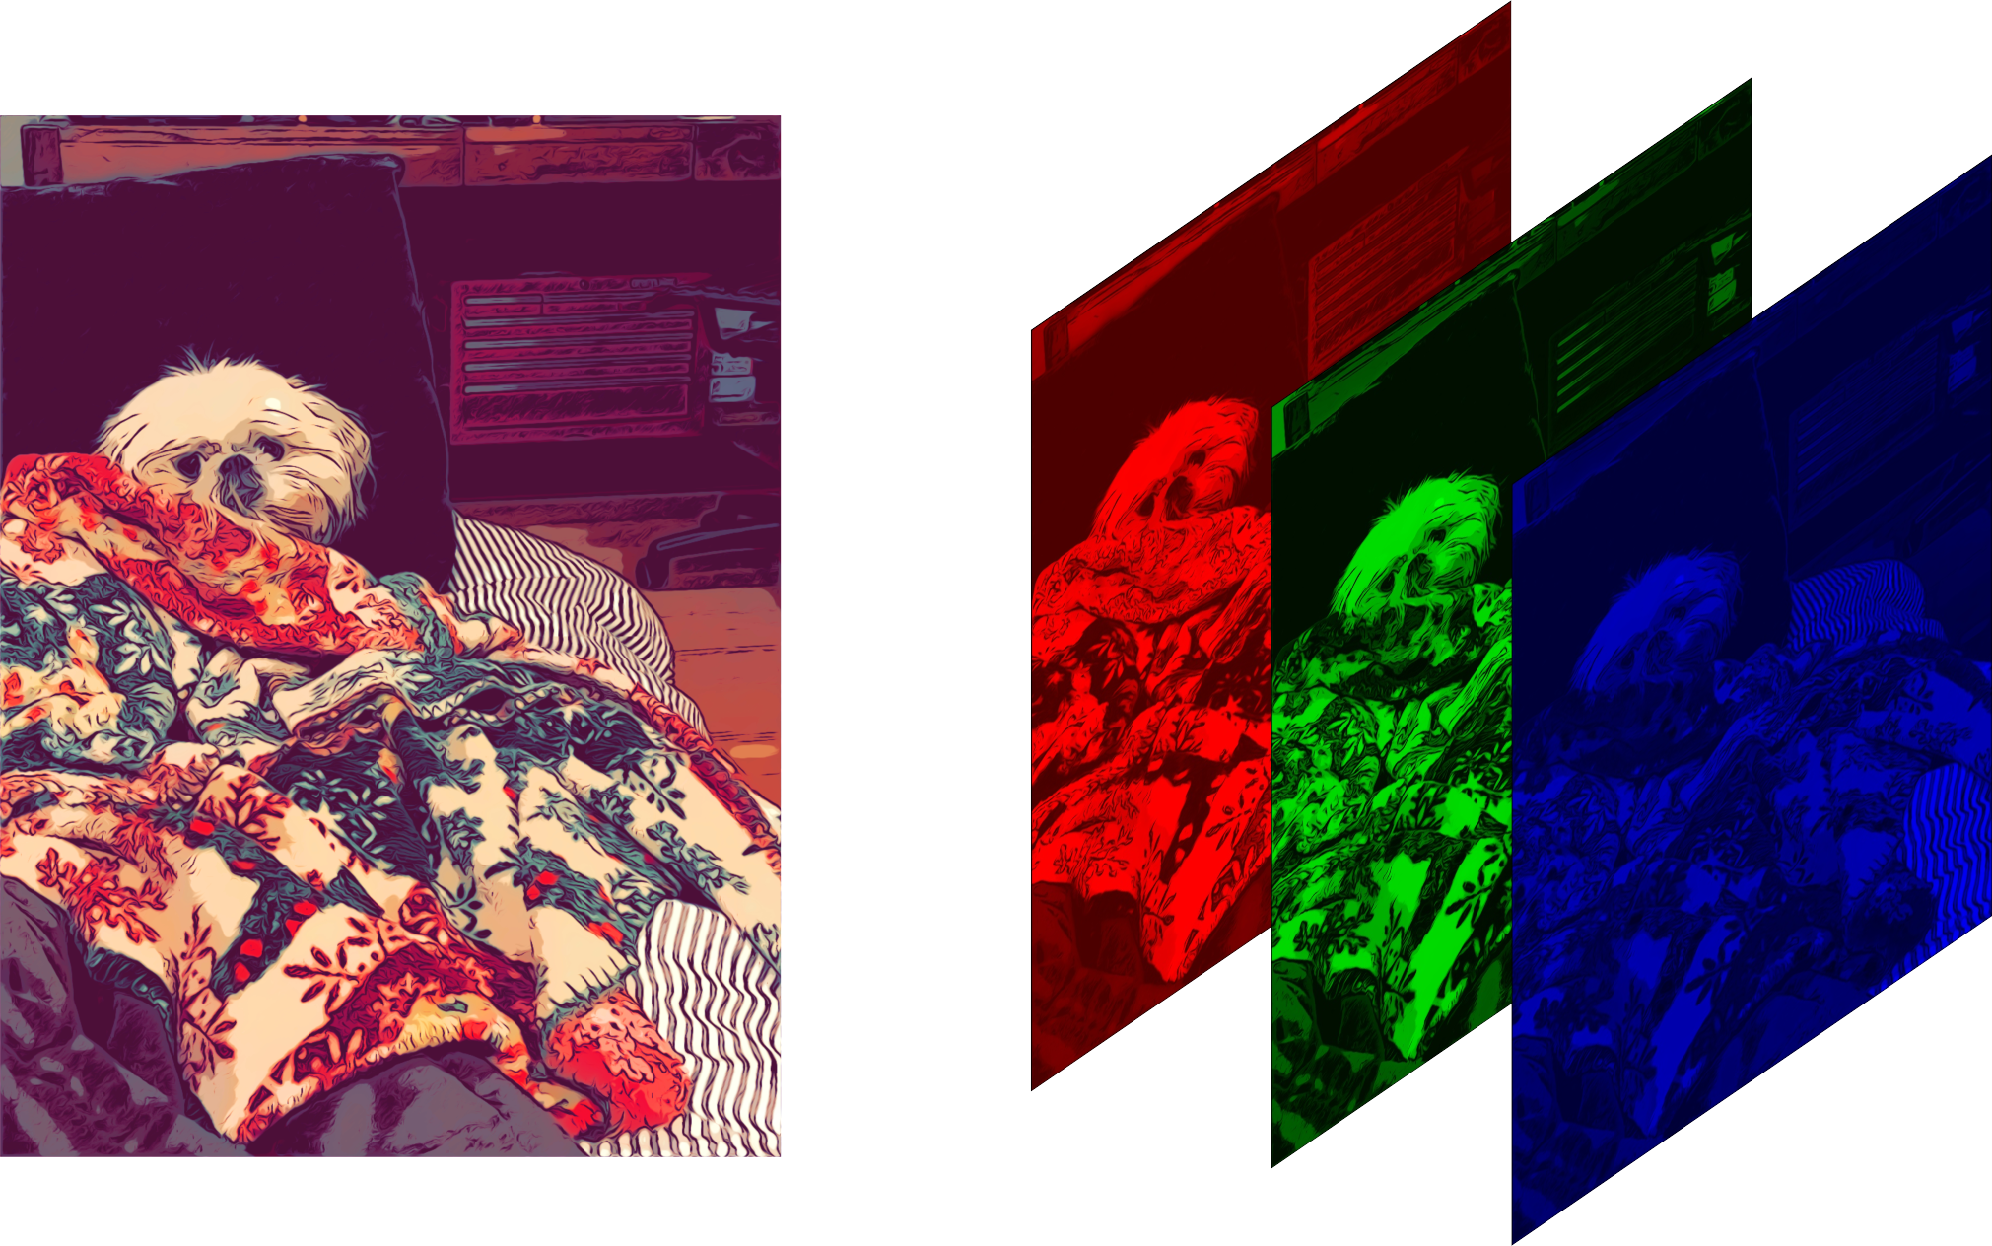
A Digital Image Representation

Slide 7
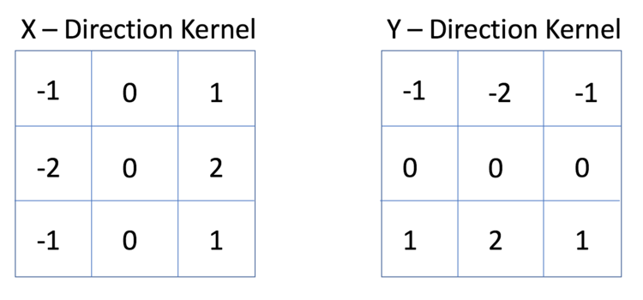
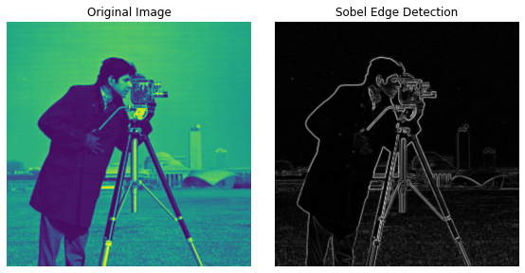
Kernel And Its Output

Slide 8


A Convolution And MaxPool Execution In Action

Slide 9

A CNN Architecture And Training

Slide 10
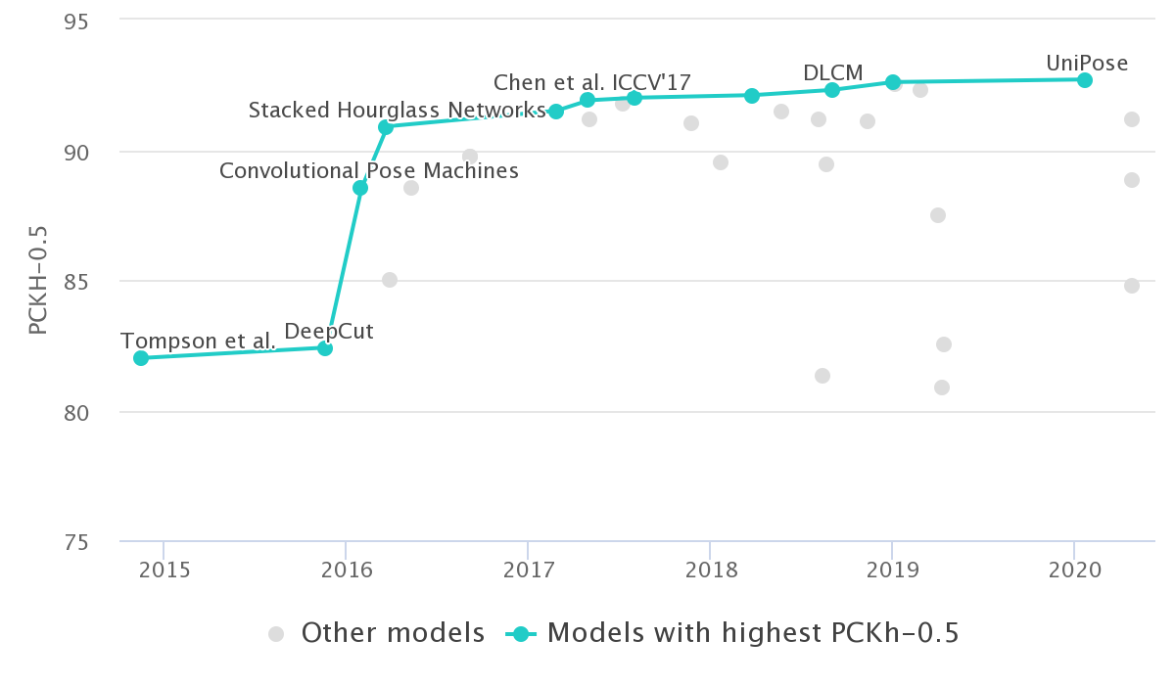
Human Pose Estimation Benchmark (PCKH-0.5)

Slide 11
The FLIC Dataset
5003 annotated images with human beings in stills from Hollywood movies
Image dimension 720 pixels x 480 pixels x 3(color image)
29 key points
Keypoint representation
[ (x1,y1), (x2,y2) ……. (xn, yn) ]^{T}
[ (120, 300), (293, 34), (-1, -1) ……. (400, 600) ]^{T}

Slide 12
Model Summary
Model: "sequential_1"
_________________________________________________________________
Layer (type) Output Shape Param #
=================================================================
conv2d_4 (Conv2D) (None, 214, 214, 96) 34944
layer_normalization_4 (Laye (None, 214, 214, 96) 192
rNormalization)
max_pooling2d_4 (MaxPooling (None, 71, 71, 96) 0
2D)
conv2d_5 (Conv2D) (None, 67, 67, 256) 614656
layer_normalization_5 (Laye (None, 67, 67, 256) 512
rNormalization)
max_pooling2d_5 (MaxPooling (None, 22, 22, 256) 0
2D)
conv2d_6 (Conv2D) (None, 20, 20, 384) 885120
layer_normalization_6 (Laye (None, 20, 20, 384) 768
rNormalization)
max_pooling2d_6 (MaxPooling (None, 6, 6, 384) 0
2D)
conv2d_7 (Conv2D) (None, 4, 4, 256) 884992
layer_normalization_7 (Laye (None, 4, 4, 256) 512
rNormalization)
max_pooling2d_7 (MaxPooling (None, 1, 1, 256) 0
2D)
flatten_1 (Flatten) (None, 256) 0
dense_3 (Dense) (None, 4096) 1052672
dropout_2 (Dropout) (None, 4096) 0
dense_4 (Dense) (None, 4096) 16781312
dropout_3 (Dropout) (None, 4096) 0
dense_5 (Dense) (None, 58) 237626
=================================================================
Total params: 20,493,306
Trainable params: 20,493,306
Non-trainable params: 0

Slide 13
x₁
x₂
x₃
x₄
x₅
x₆
.
.
.
.
.
.
.
.
y₂₆
y₂₇
y₂₈
y₂₉
F
C
OUTPUT LAYER
Image
Hidden Layers

Slide 14
Training Parameters
Epochs = 100
Batch Size = 32
Optimizer = Adam
Learning Rate = 0.0001
Loss = Mean Squared Error
Training Size = 4000 Images

Slide 15
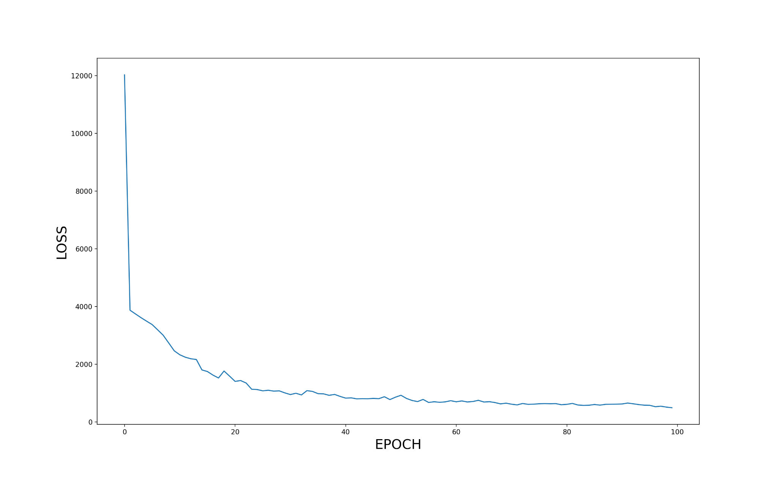
Training History
LOSS
EPOCH

Slide 16
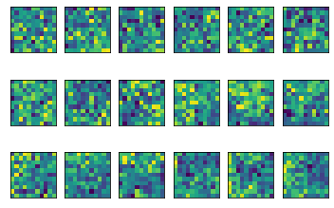
Feature Map
18 filters of 1st convolution

Slide 17
Sample Predictions

Slide 18
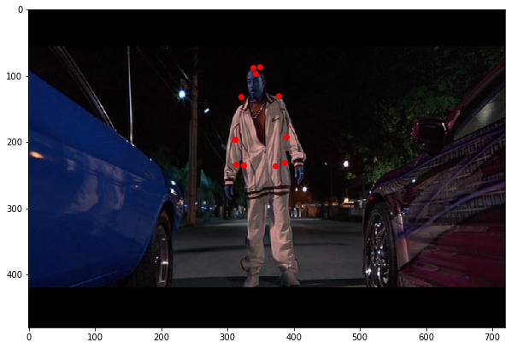

Slide 19
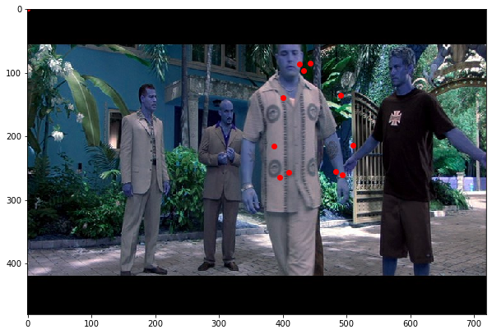

Slide 20
PCKH 0.5 Score
Body Part | Train Set | Validation Set
Right Shoulder | 0.63 | 0.54
Left Shoulder | 0.60 | 0.48
Right Wrist | 0.54 | 0.37

Slide 21
Performance
Intel i5 12th generation Asus ultrabook
No GPU
~ 0.086 seconds for a forward pass (estimation)
~ 11 frames per second

Slide 22
THANK YOU

